Slide 2
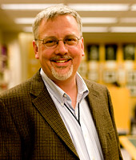
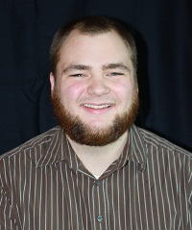
ABOUT ME
Steve Perisho, M.Div., Th.M.
Theology and Philosophy Librarian
Sorts of things I’m the go-to for:
  Reference questions/information of all sorts, incl. help with the identification and procurement of sources
  Assistance with a particular assignment, research project, or thesis
    Group
    Individual
  Collection development (suggestions for purchase)
  Special Collections
  etc.
206 281 2417
sperisho@spu.edu

Slide 3
ORIENTATION OPTIONS

Slide 4
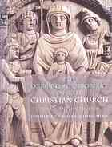



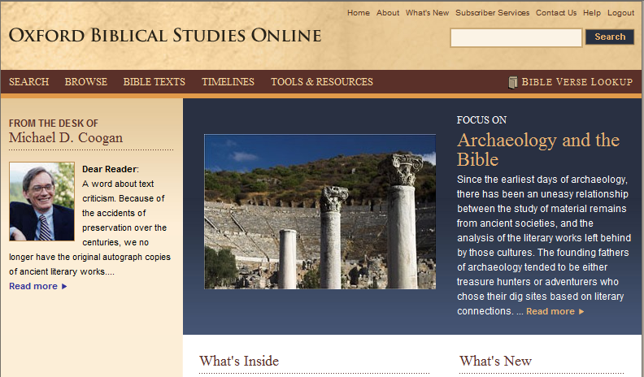
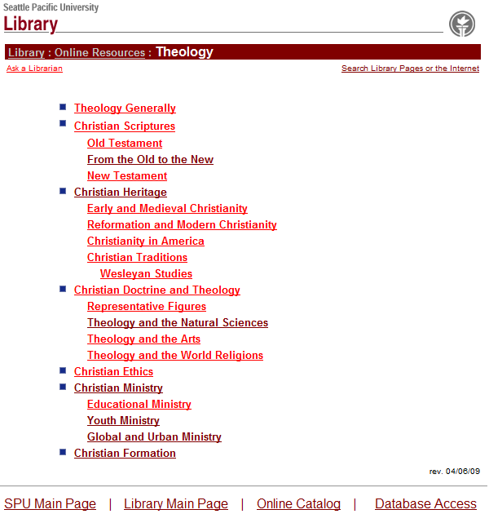
REFERENCE
Four stop-gap handouts (more in the back)
E-reference . For example,

Slide 5



BOOKS AND MORE
WorldCat (InterLibrary Loan (ILL))
WorldCat First Search, Harvard University, Princeton Seminary, and beyond
Public libraries (SPL, KCLS, etc.)
PSAIL (NWU, PLU)
OCA (Summit borrowing, adopted borrowing)
SPU

Slide 6
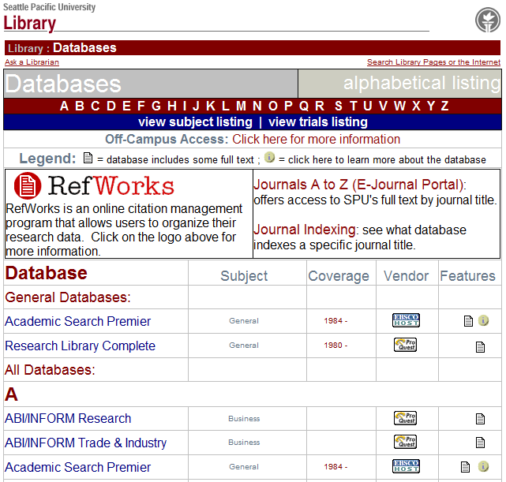
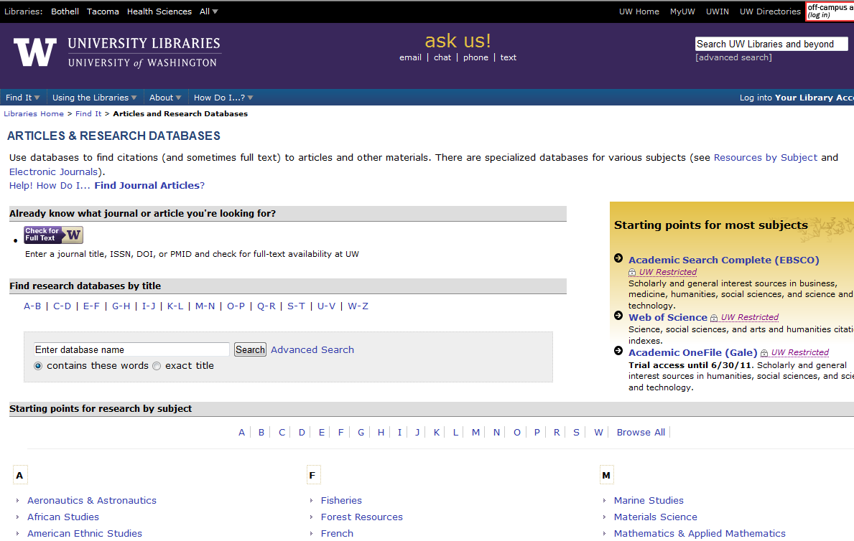
ARTICLES
Databases at SPU
  Periodical indices at SPU in print
  Securing articles
Databases free over the Web
Databases at the UW

Slide 7


Slide 8
QUESTIONS?

Slide 9
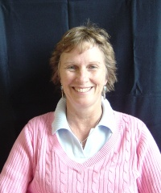
ABOUT ME
Steve Perisho, M.Div., Th.M.
Theology and Philosophy Librarian
Sorts of things I’m the go-to for:
  Reference questions/information of all sorts, incl. help with the identification and procurement of sources
  Assistance with a particular assignment, research project, or thesis
    Group
    Individual
  Collection development (suggestions for purchase)
  Special Collections
  Etc. (I know more than I can say)
206 281 2417
sperisho@spu.edu

Slide 12
ABOUT ME
Steve Perisho, M.Div., Th.M.
Theology and Philosophy Librarian
Sorts of things I’m the go-to for:
  Reference questions/information of all sorts, incl. help with the identification and procurement of sources
  Assistance with a particular assignment, research project, or thesis
    Group
    Individual
  Collection development (suggestions for purchase)
  Special Collections
  etc.
206 281 2417
sperisho@spu.edu

