Slide 2
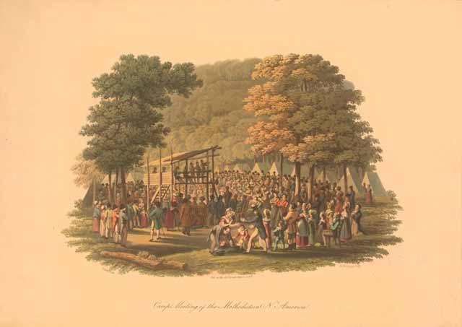
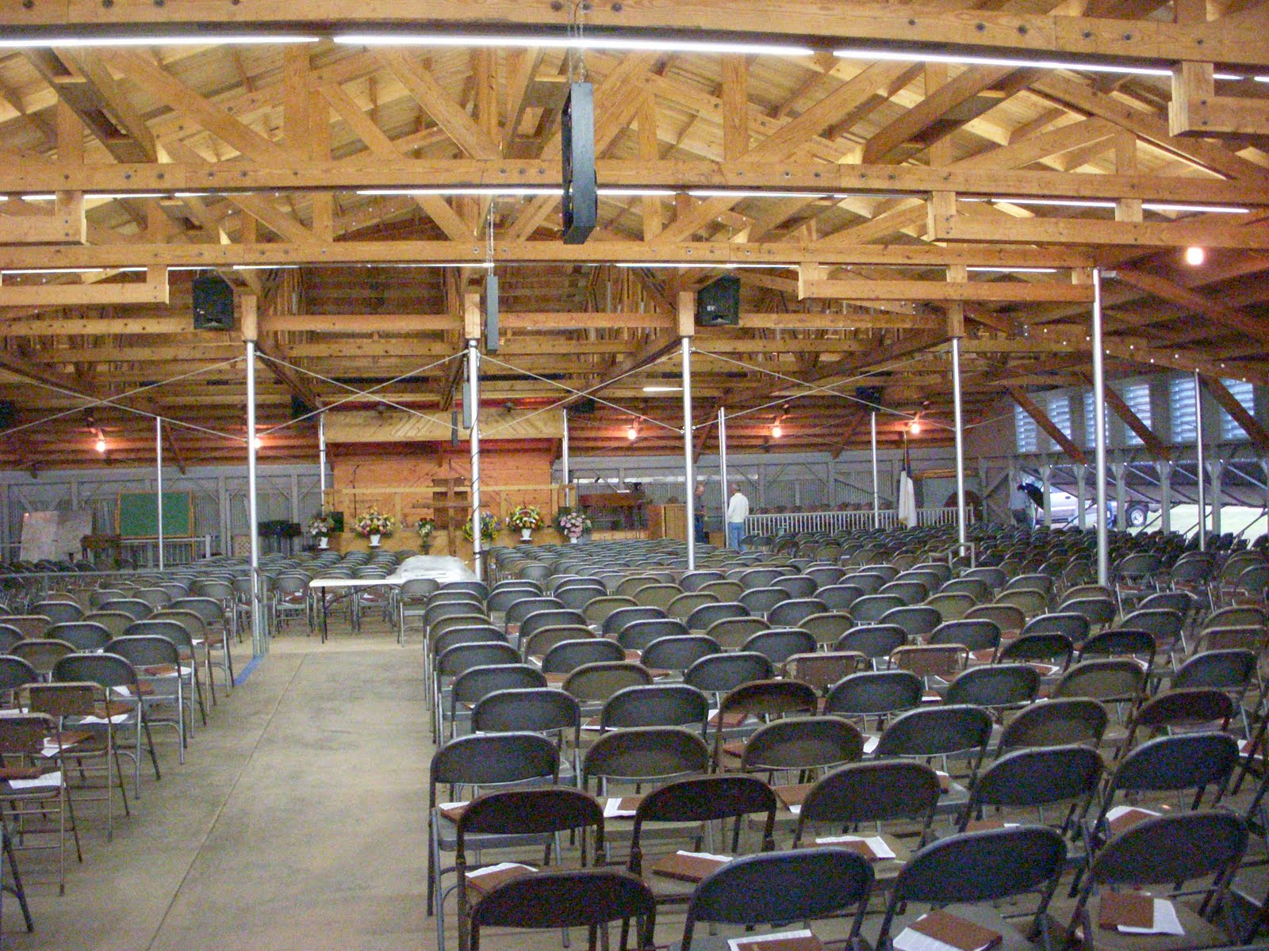
YOU’VE BEEN AT IT FOR A COUPLE OF WEEKS.
ANY QUESTIONS?

Slide 3
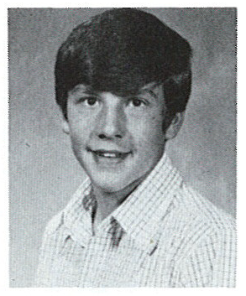
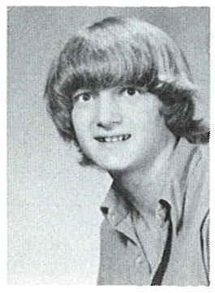
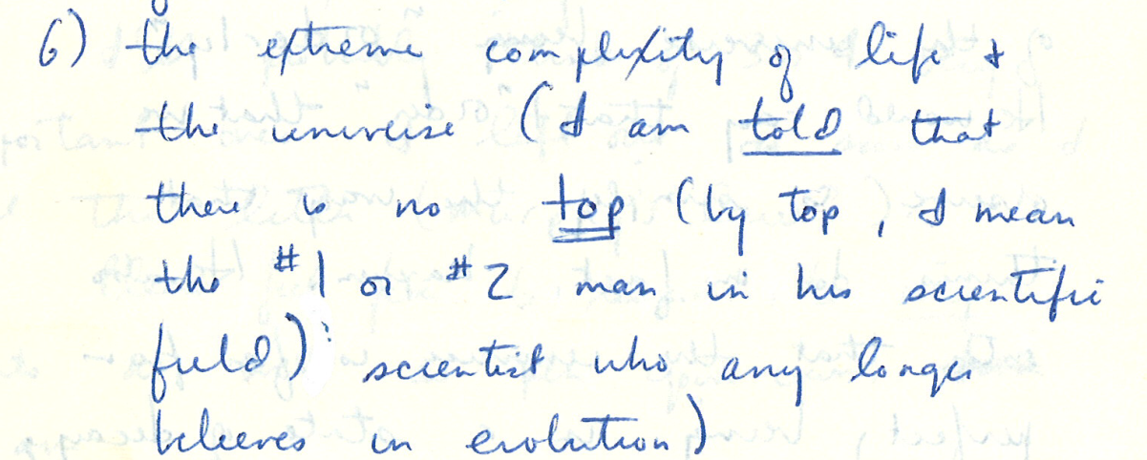
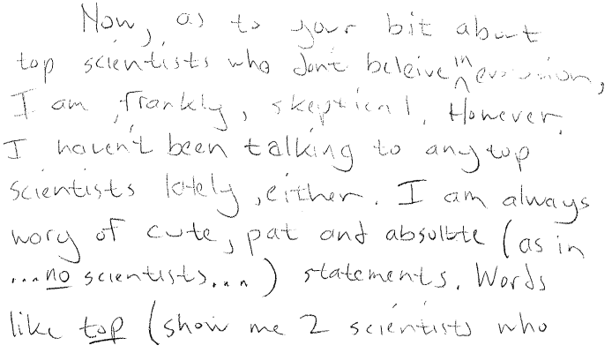
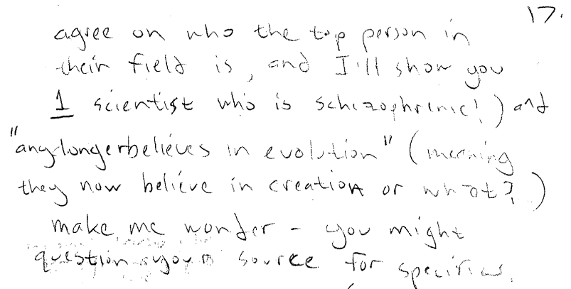
IMPORTANCE OF GOOD INFORMATION

Slide 4
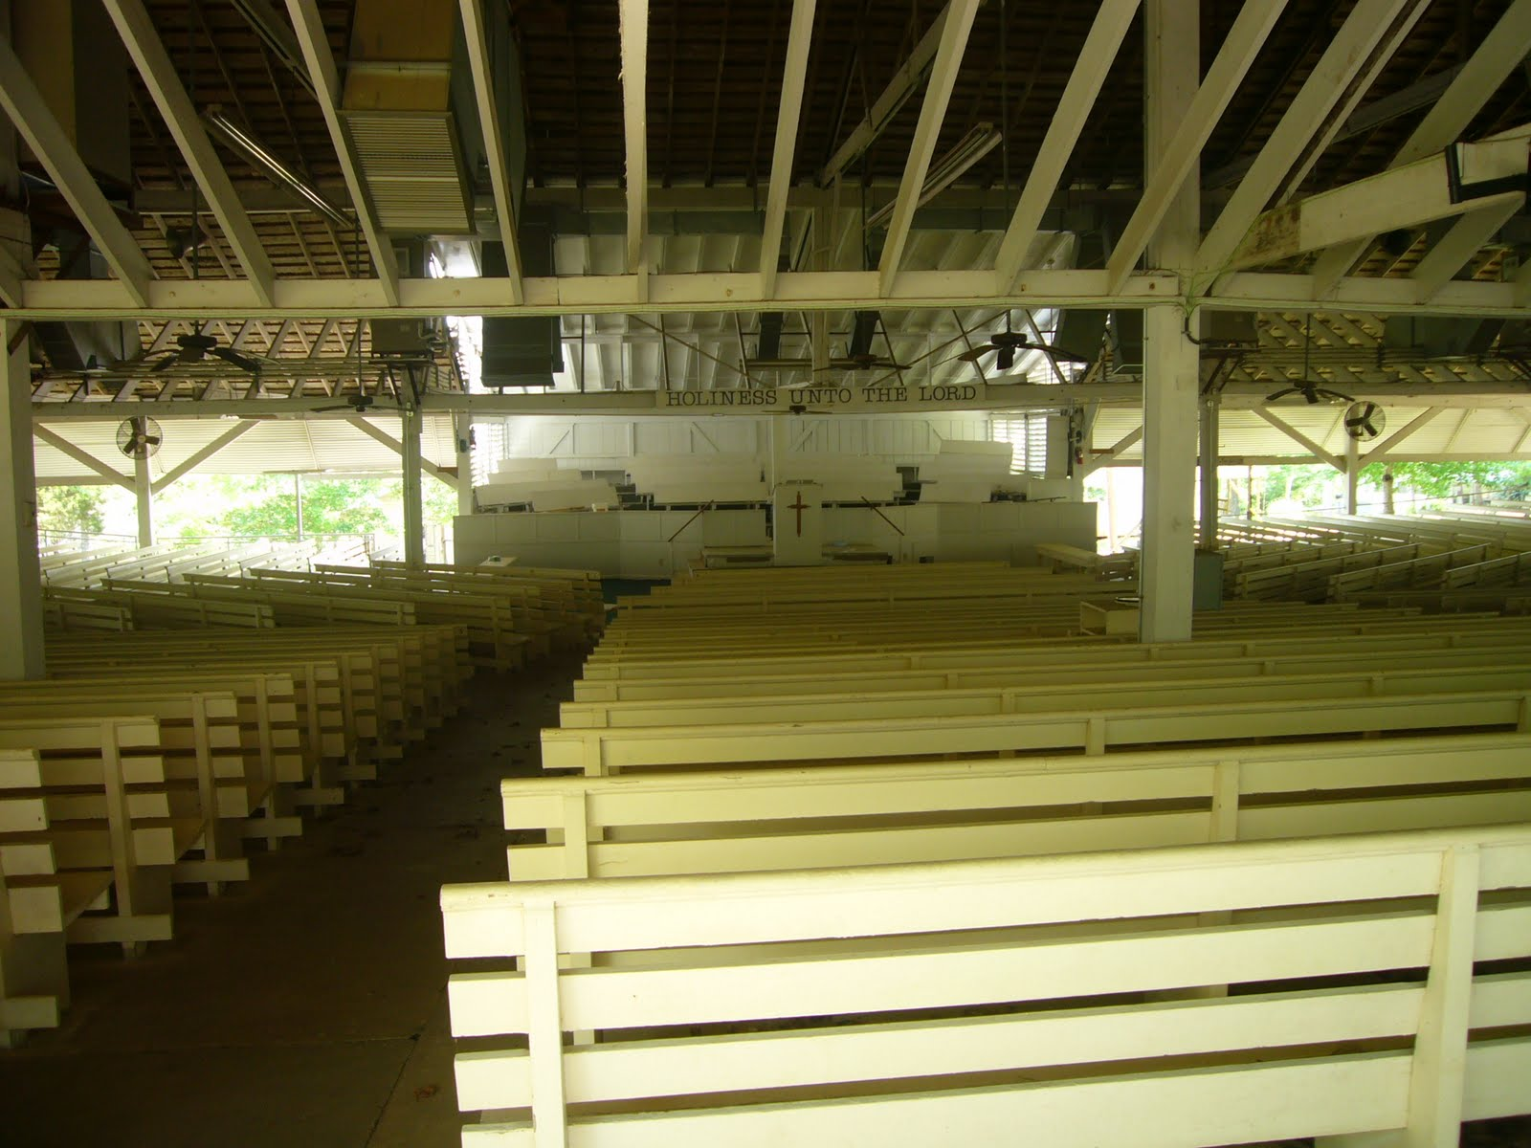
IMPORTANCE OF GOOD INFORMATION

Slide 5
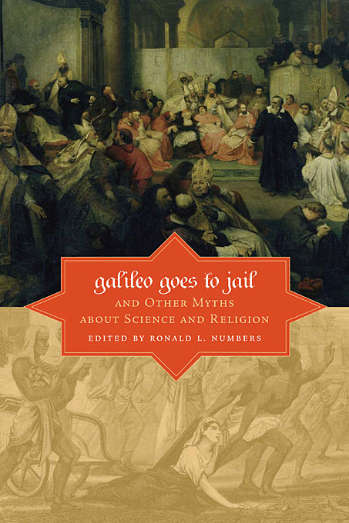
IMPORTANCE OF GOOD INFORMATION

Slide 6
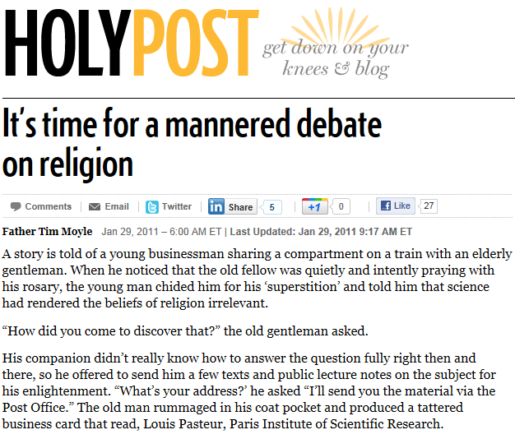
IMPORTANCE OF GOOD INFORMATION

Slide 7
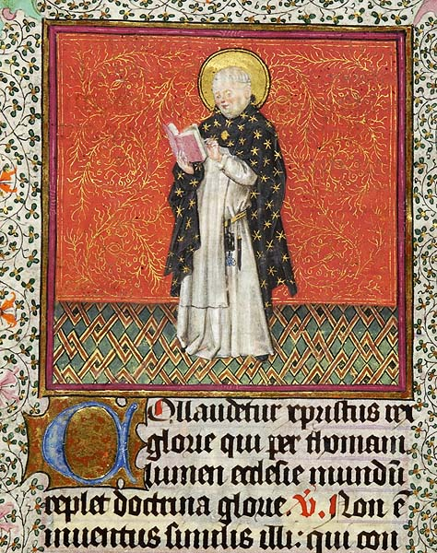
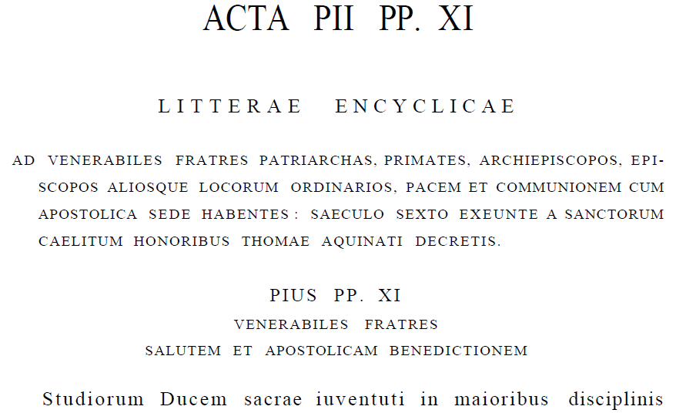
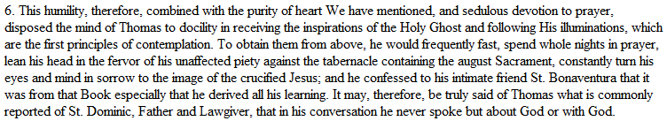
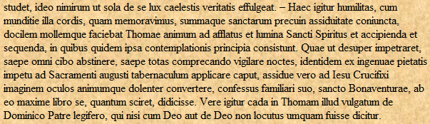
IMPORTANCE OF GOOD INFORMATION
AAS 15, no. 7 (1923): 311-312 (309-326).

Slide 8
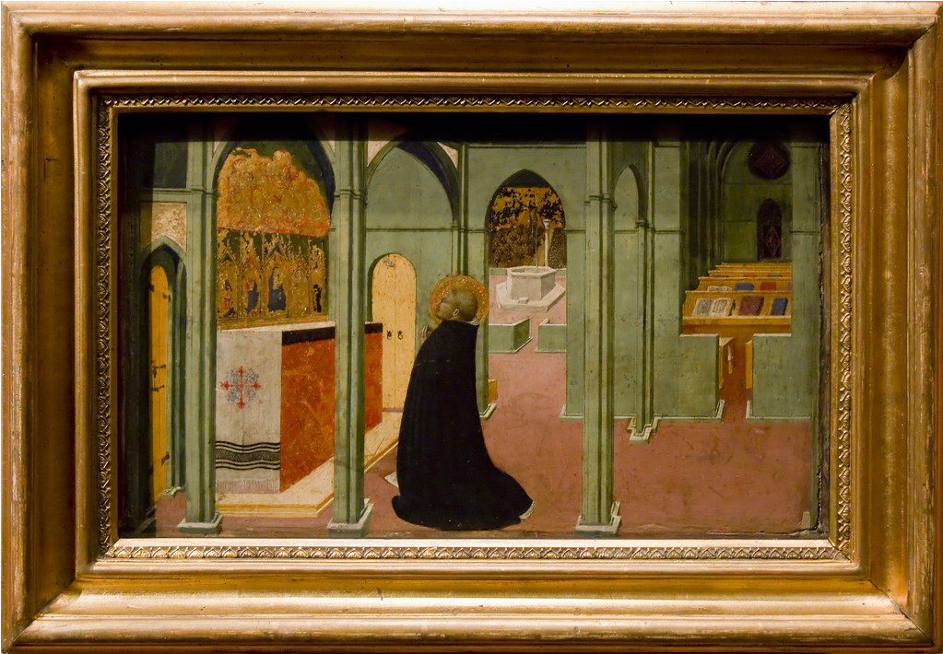
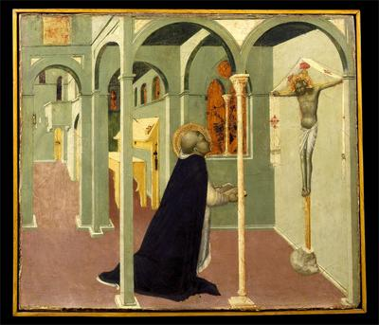
IMPORTANCE OF GOOD INFORMATION
Sassetta (c.1400-1450). Vision of St. Thomas Aquinas. Pinocateca Vaticana. ARTstor.
Sassetta (Stefano di Giovanni di Consolo, c.1400-1450). St. Thomas in prayer. Szépművészeti Múzeum (Museum of Fine Arts), Budapest.

Slide 9
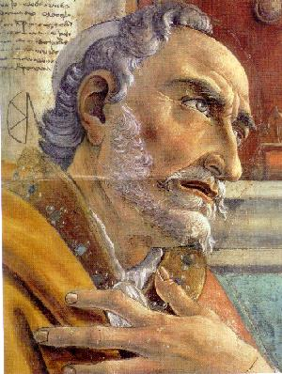

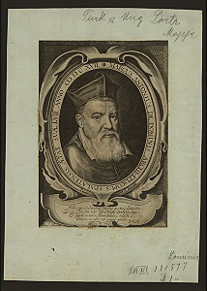
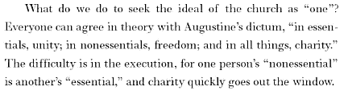
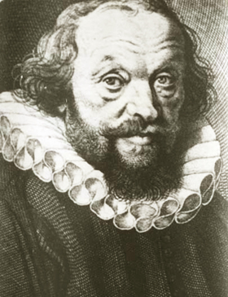
IMPORTANCE OF GOOD INFORMATION

Slide 10

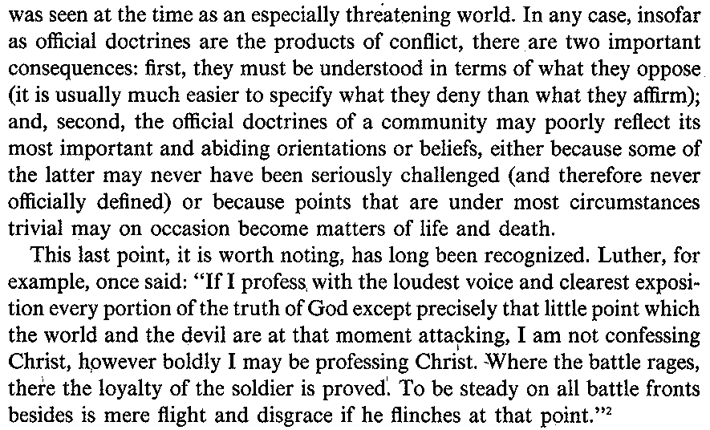
IMPORTANCE OF GOOD INFORMATION

Slide 11
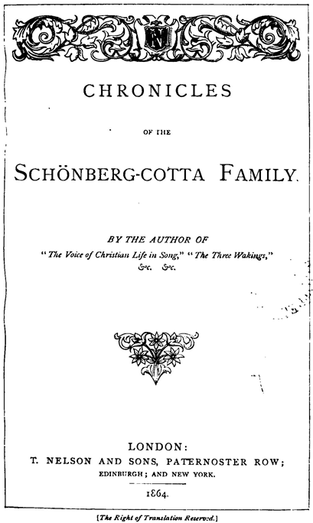
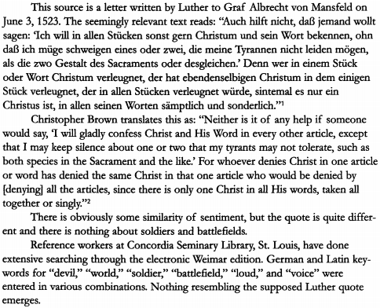
IMPORTANCE OF GOOD INFORMATION

Slide 12

IMPORTANCE OF GOOD INFORMATION

Slide 13
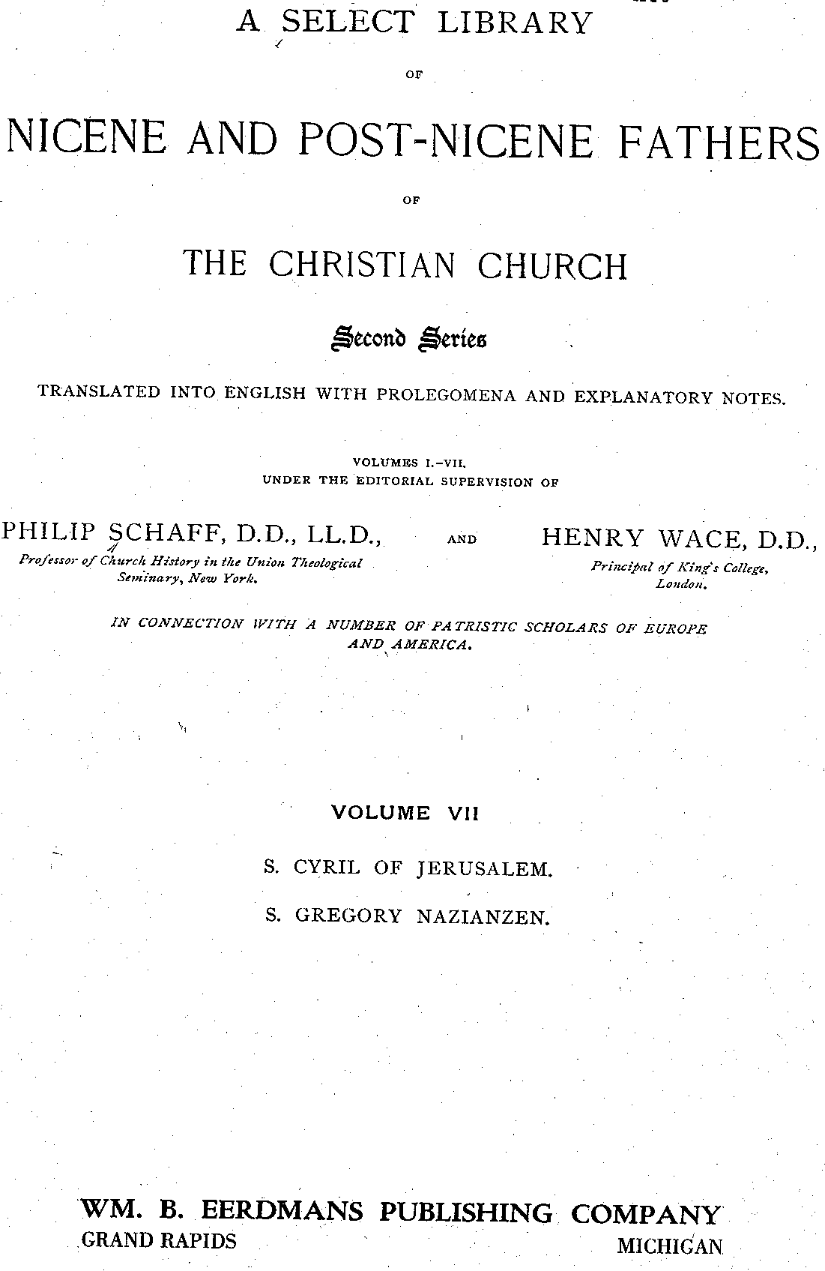
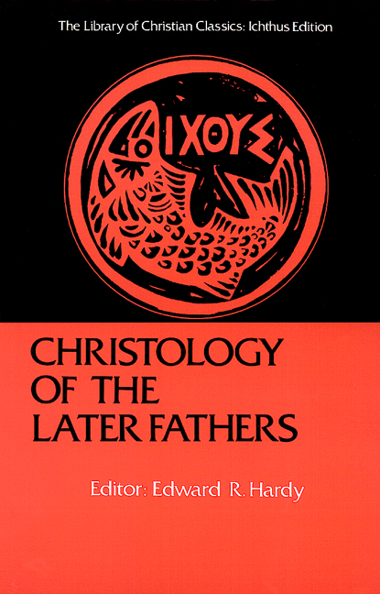
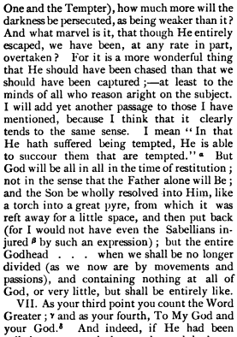
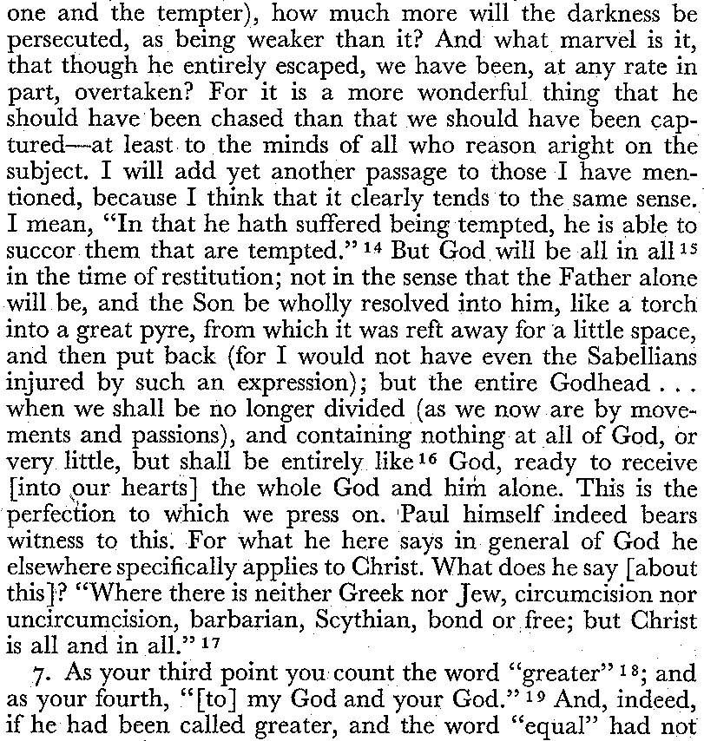
IMPORTANCE OF GOOD INFORMATION
Gregory of Nazianzus, Fourth theological oration 6.

Slide 14
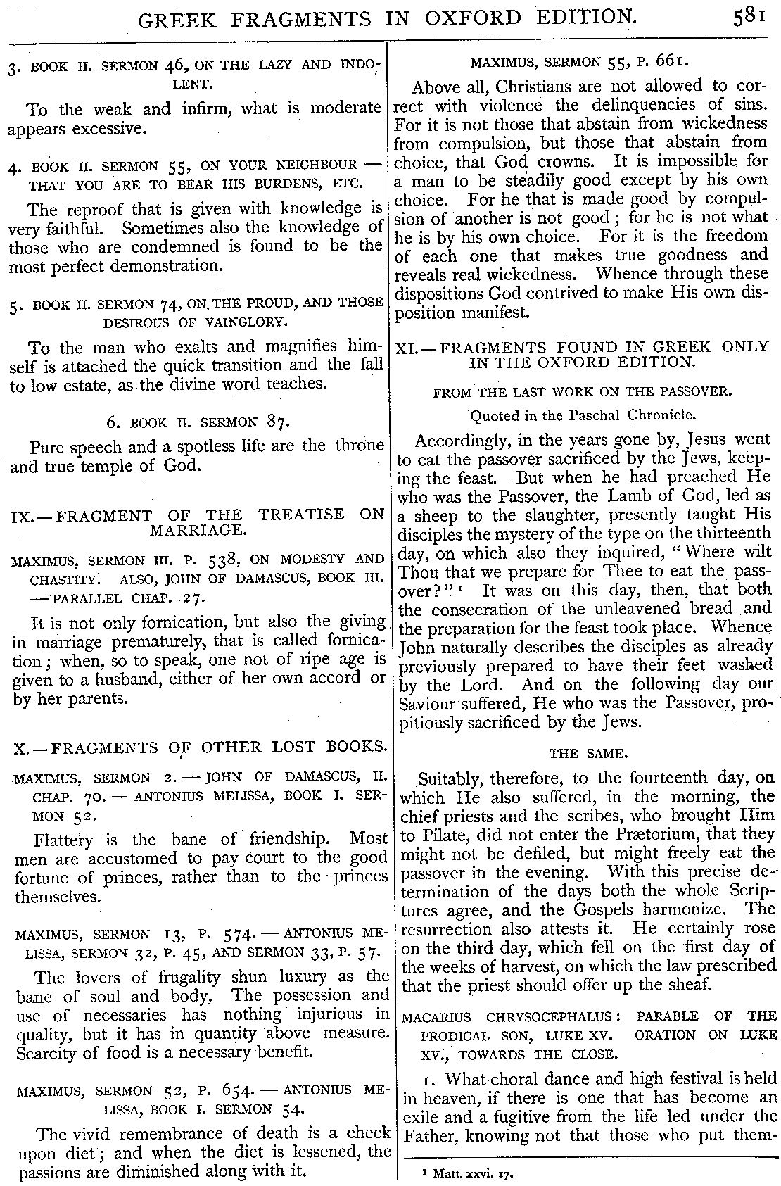
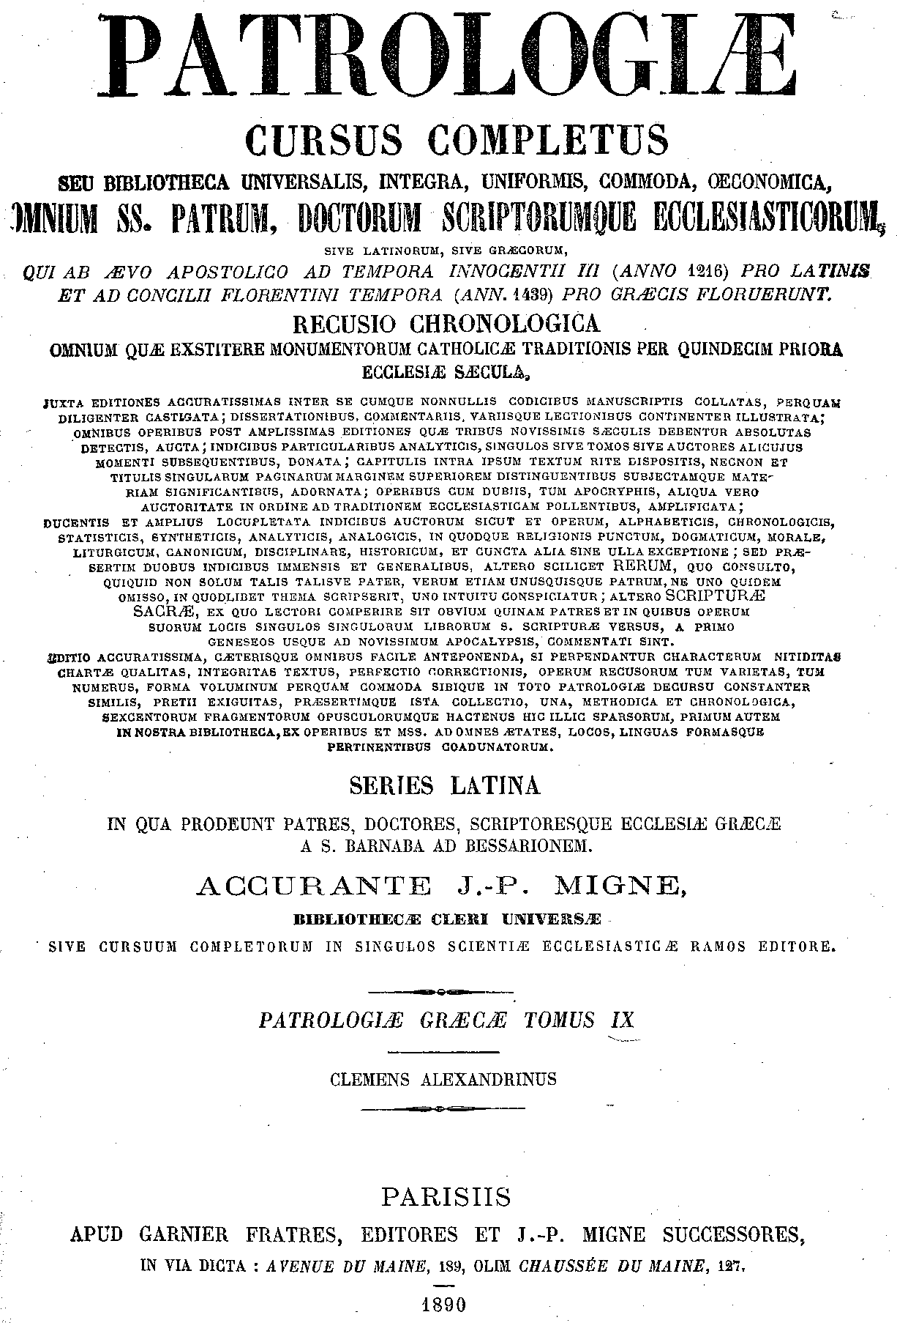
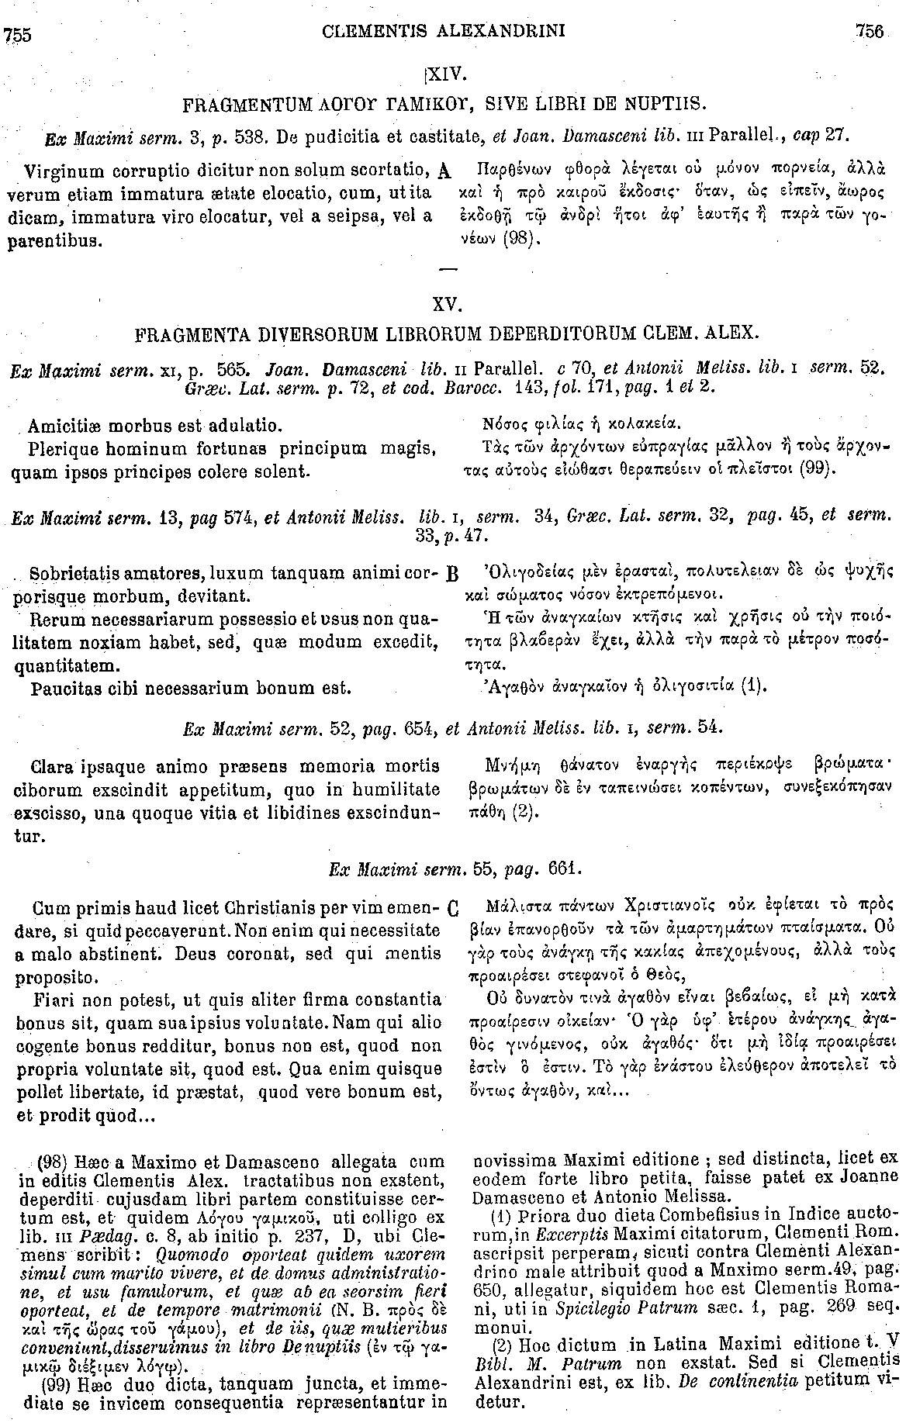
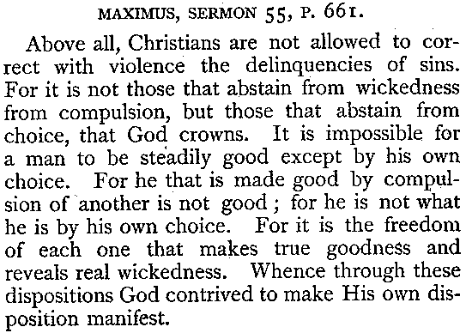
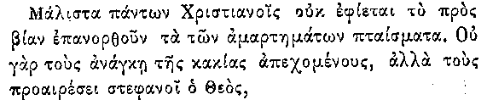
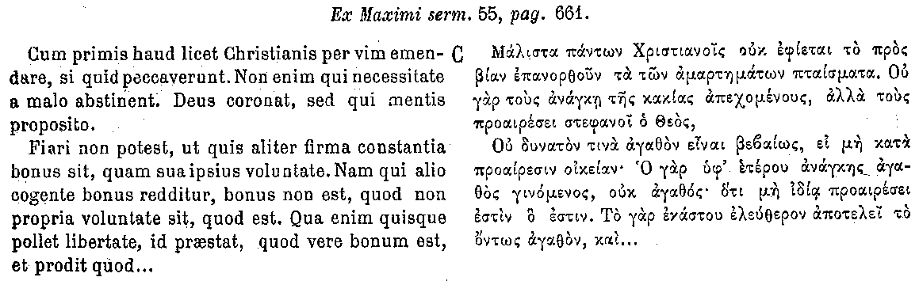
IMPORTANCE OF GOOD INFORMATION

Slide 15
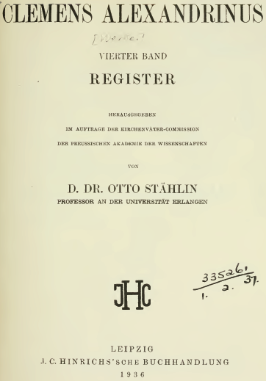
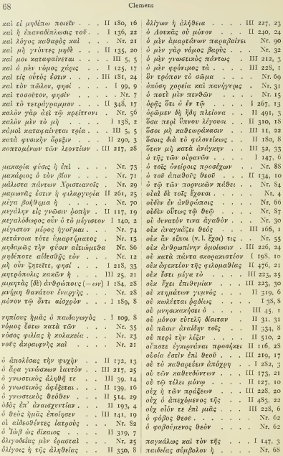
IMPORTANCE OF GOOD INFORMATION

Slide 16
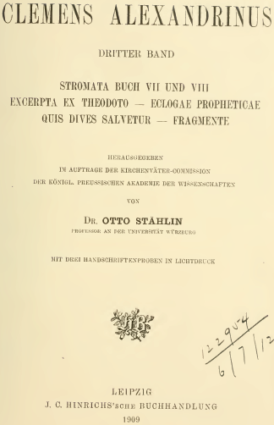
IMPORTANCE OF GOOD INFORMATION

Slide 17
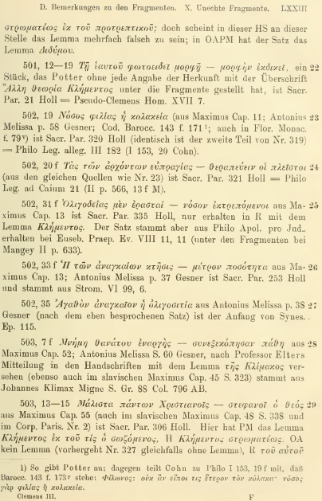
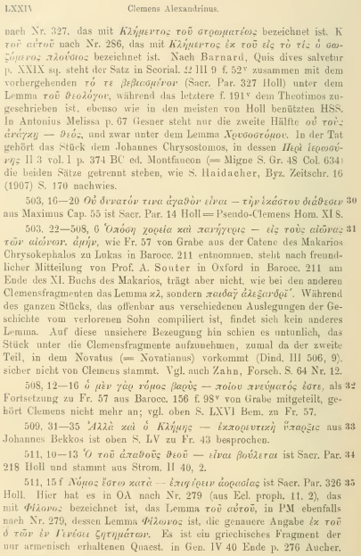

IMPORTANCE OF GOOD INFORMATION

Slide 18
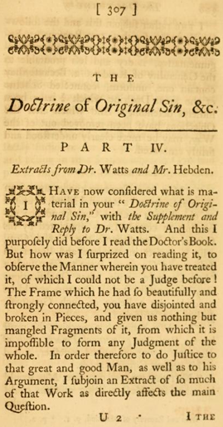
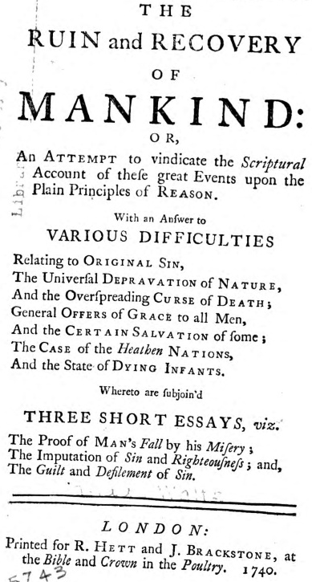
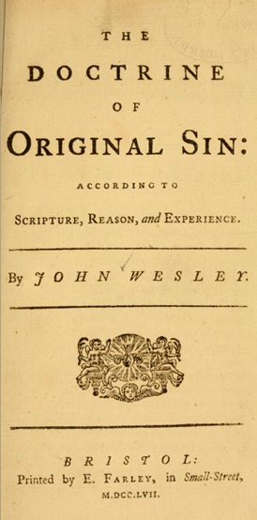
IMPORTANCE OF GOOD INFORMATION (via Randy Maddox)

Slide 19
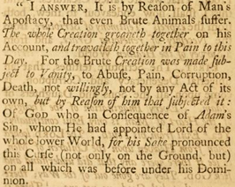
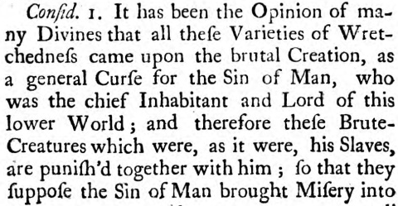
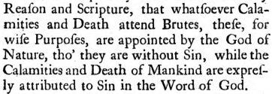
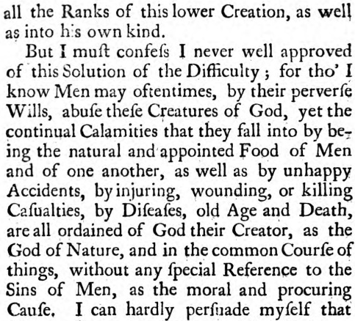

IMPORTANCE OF GOOD INFORMATION (via Randy Maddox)

Slide 20
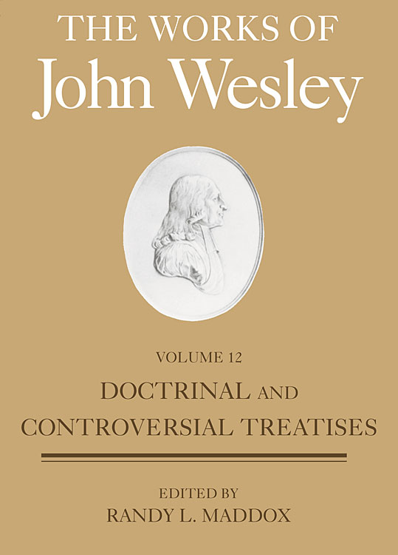
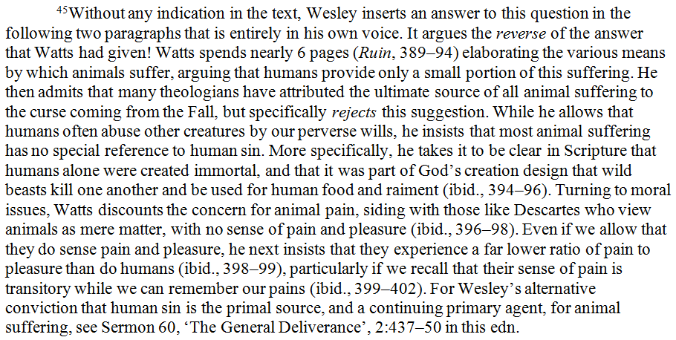
IMPORTANCE OF GOOD INFORMATION (via Randy Maddox)

Slide 21
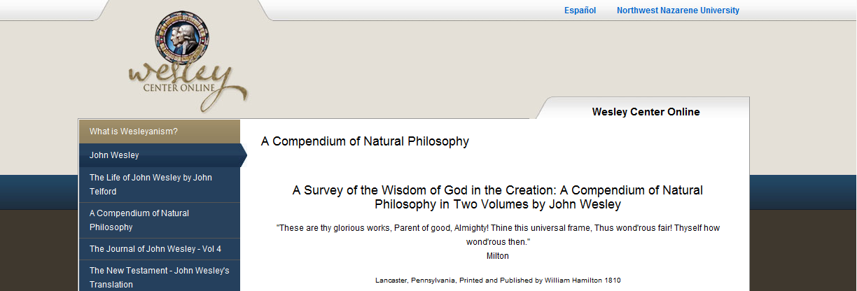
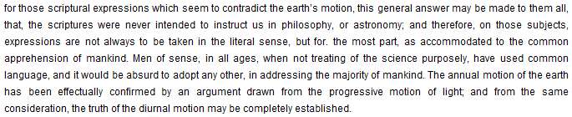
IMPORTANCE OF GOOD INFORMATION (via Randy Maddox)

Slide 22
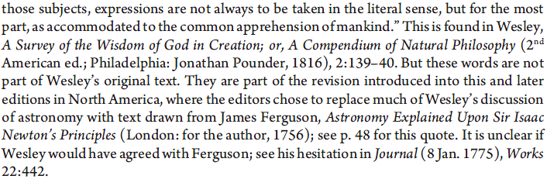
IMPORTANCE OF GOOD INFORMATION (via Randy Maddox)

Slide 23

IMPORTANCE OF GOOD INFORMATION

Slide 24
OUTLINE
Handouts
How to search (search technique)
Where to search
  Works of reference. Example: Augustine only, dictionaries and encyclopedias only
    Principle: from the general to the highly specialized
  Library catalogs (books)
  Securing books
  BREAK FOR APPLICATION
  Serial bibliographies, indices, or “databases” (articles)
      non-serial bibliographies
      serial bibliographies. Example: Augustine only
    Principle: from the general to the highly specialized
  Securing articles
Creating lists, RefWorks

Slide 25





HOW TO SEARCH
Searching no substitute for reading and following the “links”
The structure of an effective search, incl. Boolean operators
Additional tools
  Phrase-searching: usually “ ”
  Truncation: usually *
  Wildcards: sometimes ?, sometimes #
  Fields and field codes (as distinguished from Keywords)
  Clustering/nesting: usually ( )
  Authoritative forms (subject headings, uniform titles, name authorities)
WHERE TO SEARCH

Slide 26
WORKS OF REFERENCE
The subordinate but real value of the tertiary source
Today’s example: 1) the encyclopedia and 2) the serial bibliography. But works of reference come in many forms
What (little) a scholarly encyclopedia can provide:
    An overview, a summary, a sense of the lay of the land
    Keywords, incl. Cross references
    Starter bibliography

Slide 27

DICTIONARIES AND ENCYCLOPEDIAS

Slide 28






AND BY THE WAY

Slide 29





DICTIONARIES AND ENCYCLOPEDIAS

Slide 30




DICTIONARIES AND ENCYCLOPEDIAS

Slide 31


DICTIONARIES AND ENCYCLOPEDIAS

Slide 32



DICTIONARIES AND ENCYCLOPEDIAS

Slide 33


DICTIONARIES AND ENCYCLOPEDIAS

Slide 34




DICTIONARIES AND ENCYCLOPEDIAS

Slide 35
DICTIONARIES AND ENCYCLOPEDIAS
Patrology

Slide 36

DICTIONARIES AND ENCYCLOPEDIAS

Slide 37





DICTIONARIES AND ENCYCLOPEDIAS

Slide 38


DICTIONARIES AND ENCYCLOPEDIAS

Slide 39

DICTIONARIES AND ENCYCLOPEDIAS

Slide 40





DICTIONARIES AND ENCYCLOPEDIAS

Slide 41


DICTIONARIES AND ENCYCLOPEDIAS

Slide 42





Dictionary or encyclopedia

Slide 43





DICTIONARIES AND ENCYCLOPEDIAS

Slide 44



DICTIONARIES AND ENCYCLOPEDIAS

Slide 45
Dictionary or encyclopedia
Adam
Aeternitas
Anima, animus
Augustinus (uita)
Baptismus paruulorum
Cassiacum
Causa
Ciuitate dei (De)
Cogitatio
Cognitio
Concupiscentia
Corpus
Credere
Daemon(es)
Diuinatione daemonum (De)
Divititiae
Dolor (dolere)
Donatistae II
Ieiunium
Immortalitas
Lex
Aphorims in English:
  Crede ut intellegas
Article of the month in English:
  Frui-uti
  Iudaei
  Lazarus

Slide 46



BOOKS AND MORE
WorldCat (InterLibrary Loan (ILL))
WorldCat First Search, Harvard University, Princeton Seminary, and beyond
Public libraries (SPL, KCLS, etc.)
PSAIL (NWU, PLU)
OCA (Summit borrowing, adopted borrowing)
SPU

Slide 47





SECURING BOOKS

Slide 48
BREAK/APPLICATION

Slide 49
NON-SERIAL BIBLIOGRAPHIES
In the form of books, webpages/sites, etc.
In the form of articles, webpages/sites, etc.

Slide 50


SERIAL BIBLIOGRAPHIES

Slide 51

SERIAL BIBLIOGRAPHIES
(Augustine example)
Trinitas in Referenzen vs. (Augustine AND trinit*) in Subject
Trinitate in Referenzen vs. Augustine in Subject AND (Trinitate or “On the Trinity”) in Keyword
Know your database (coverage, technique)
General
  ATLA Religion Database with Serials (ATLAS). SPU
  Index Theologicus (IxTheo). Free online
  Catholic periodical and literature index. UW, in paper
  Christian periodical index. SPU, in paper
  Religious and theological abstracts. SPU, in paper (dead)
  etc.
Specialized
  Bibliographical Information Database in Patristics (and predecessors). Free online
  L’Année Philologique. UW
  etc.
Highly specialized
  “Bulletin Augustinien” (Revue des études augustiniennes (et patristiques)). Earlier years free online
  Augustinus-Literatur-Portal. Free online
  etc.
Non-Augustinian examples, just quickly, e.g.

Slide 52

SECURING ARTICLES

Slide 53

SECURING ARTICLES
From within an SPU database (e.g. ATLAS)
From within a non-SPU database (e.g. Augustinus-Literatur-Portal), or on the basis of a citation of some sort (footnote, bibliography, faculty reference)
Internet; UW, SU, etc.

Slide 54

SECURING ARTICLES

Slide 55

COURSE RESERVES

Slide 56

LIBRARY RECORDS

Slide 57

Creating lists, RefWorks

Slide 58


CONTACT INFO
Steve Perisho
Theology and Philosophy Librarian
206 281 2417
sperisho@spu.edu

