Slide 1
Attendance

Slide 2
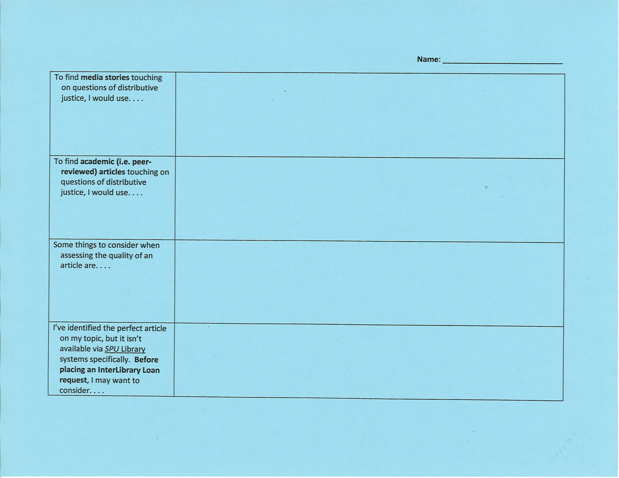

Slide 3
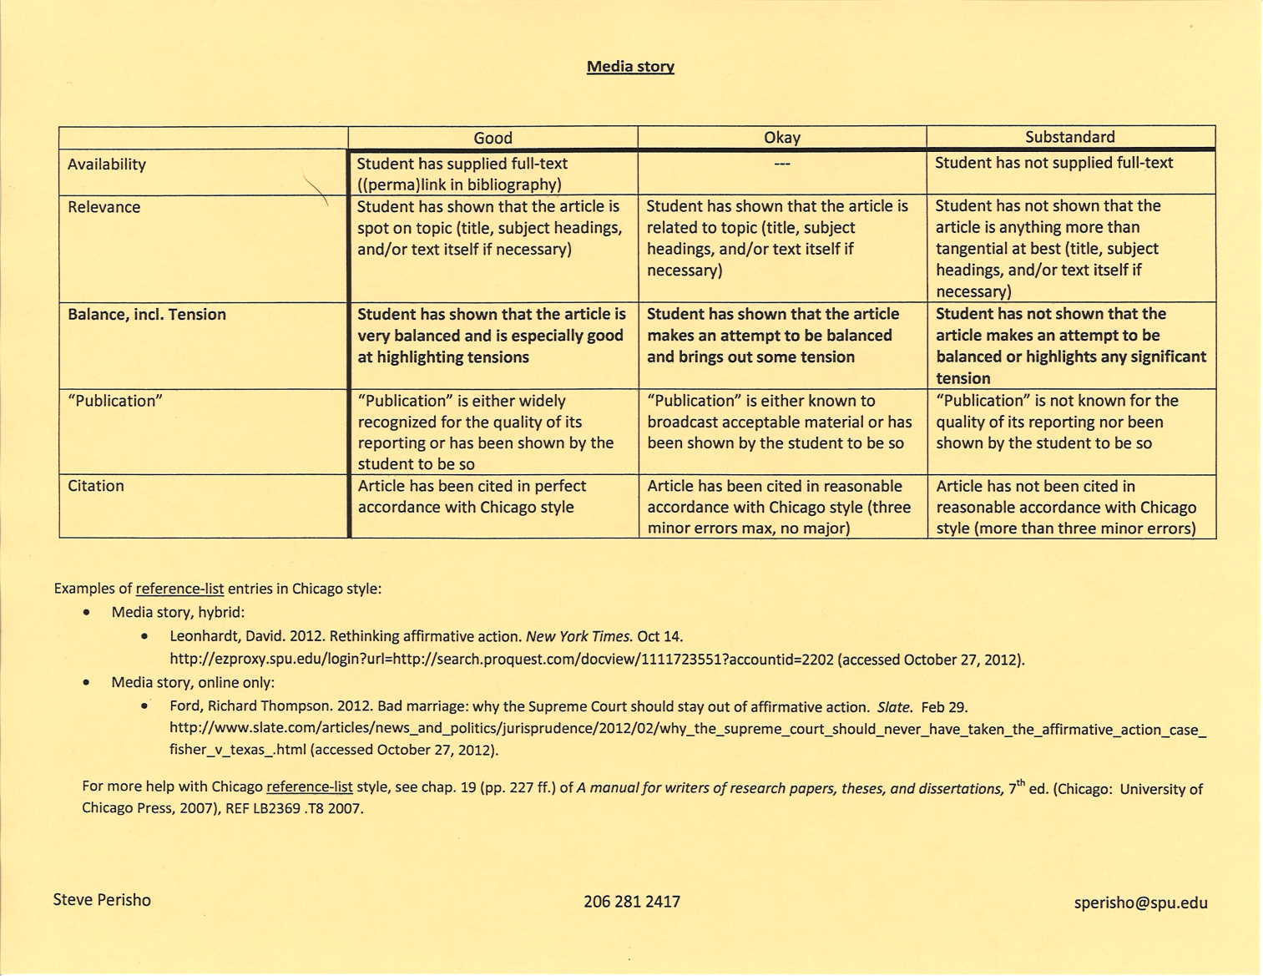
The screen shot below is not a screen shot of the final version you have in hand:

Slide 4
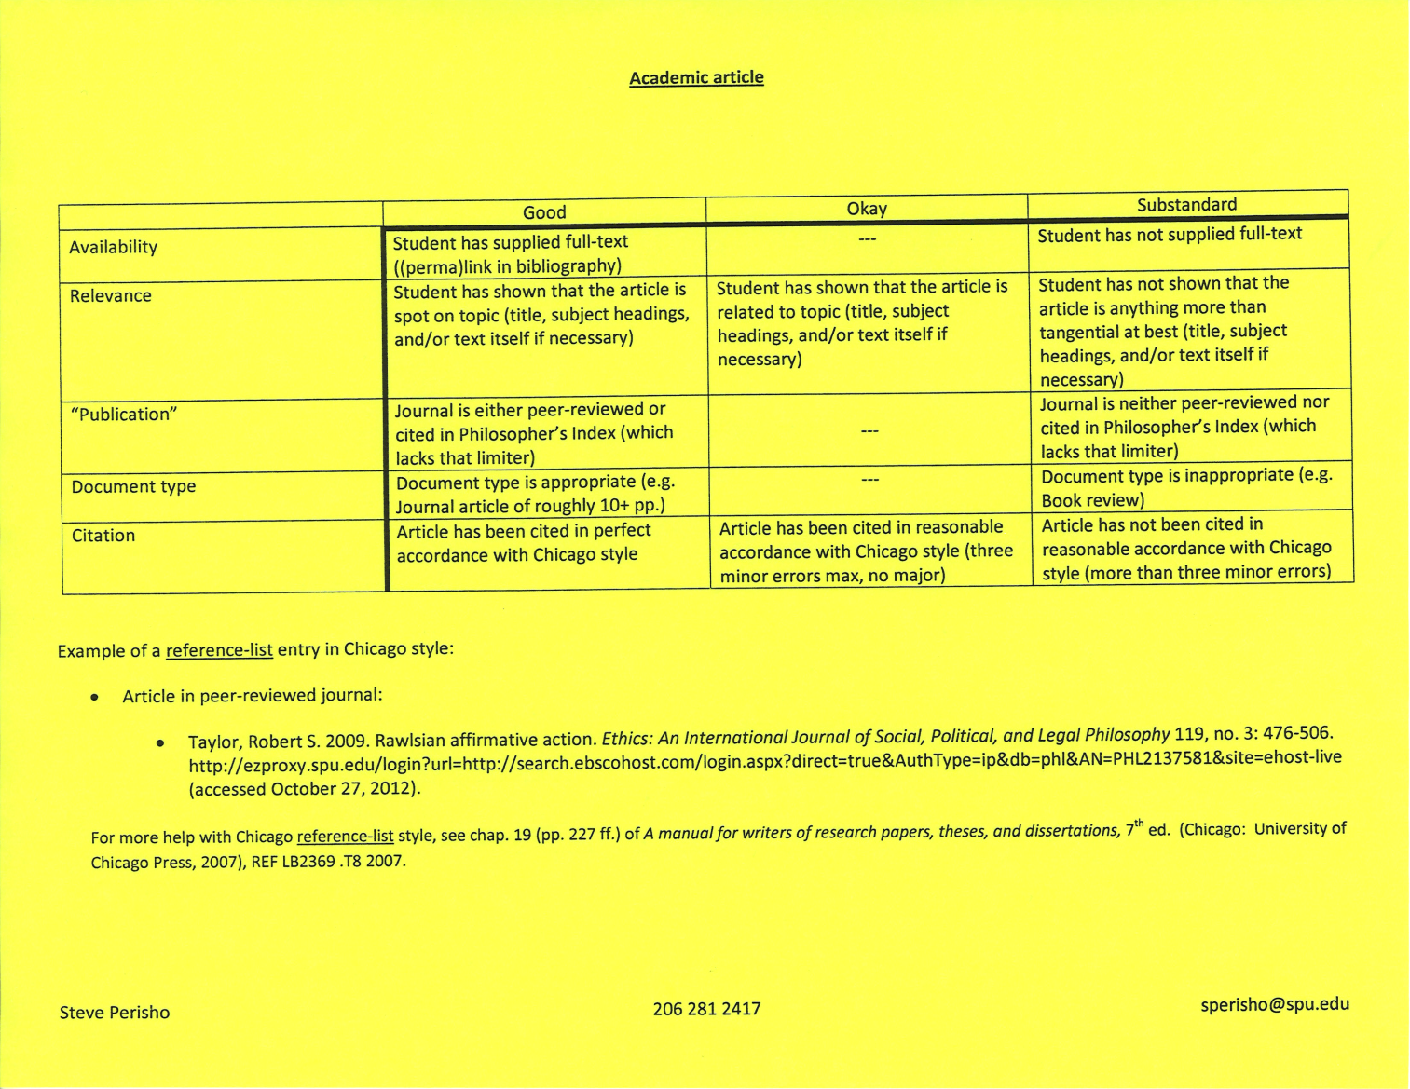
The screen shot below is not a screen shot of the final version you have in hand:

Slide 5
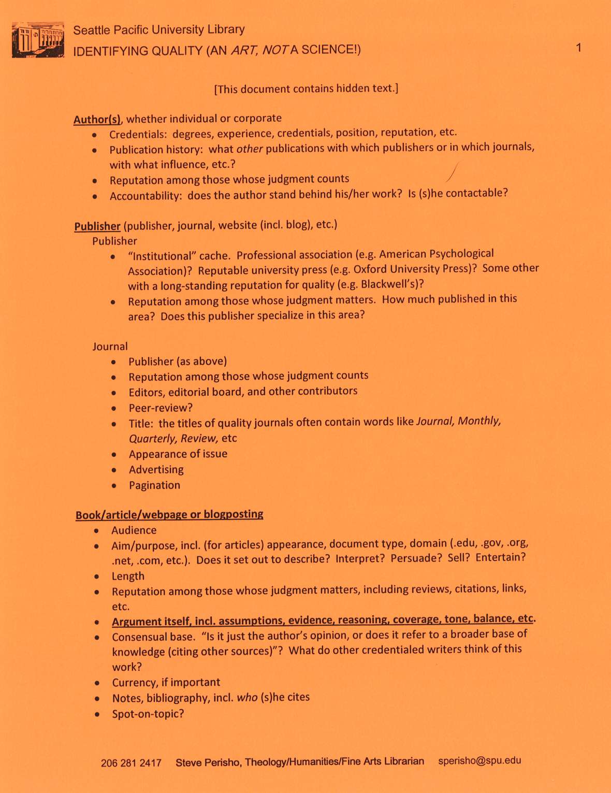

Slide 6
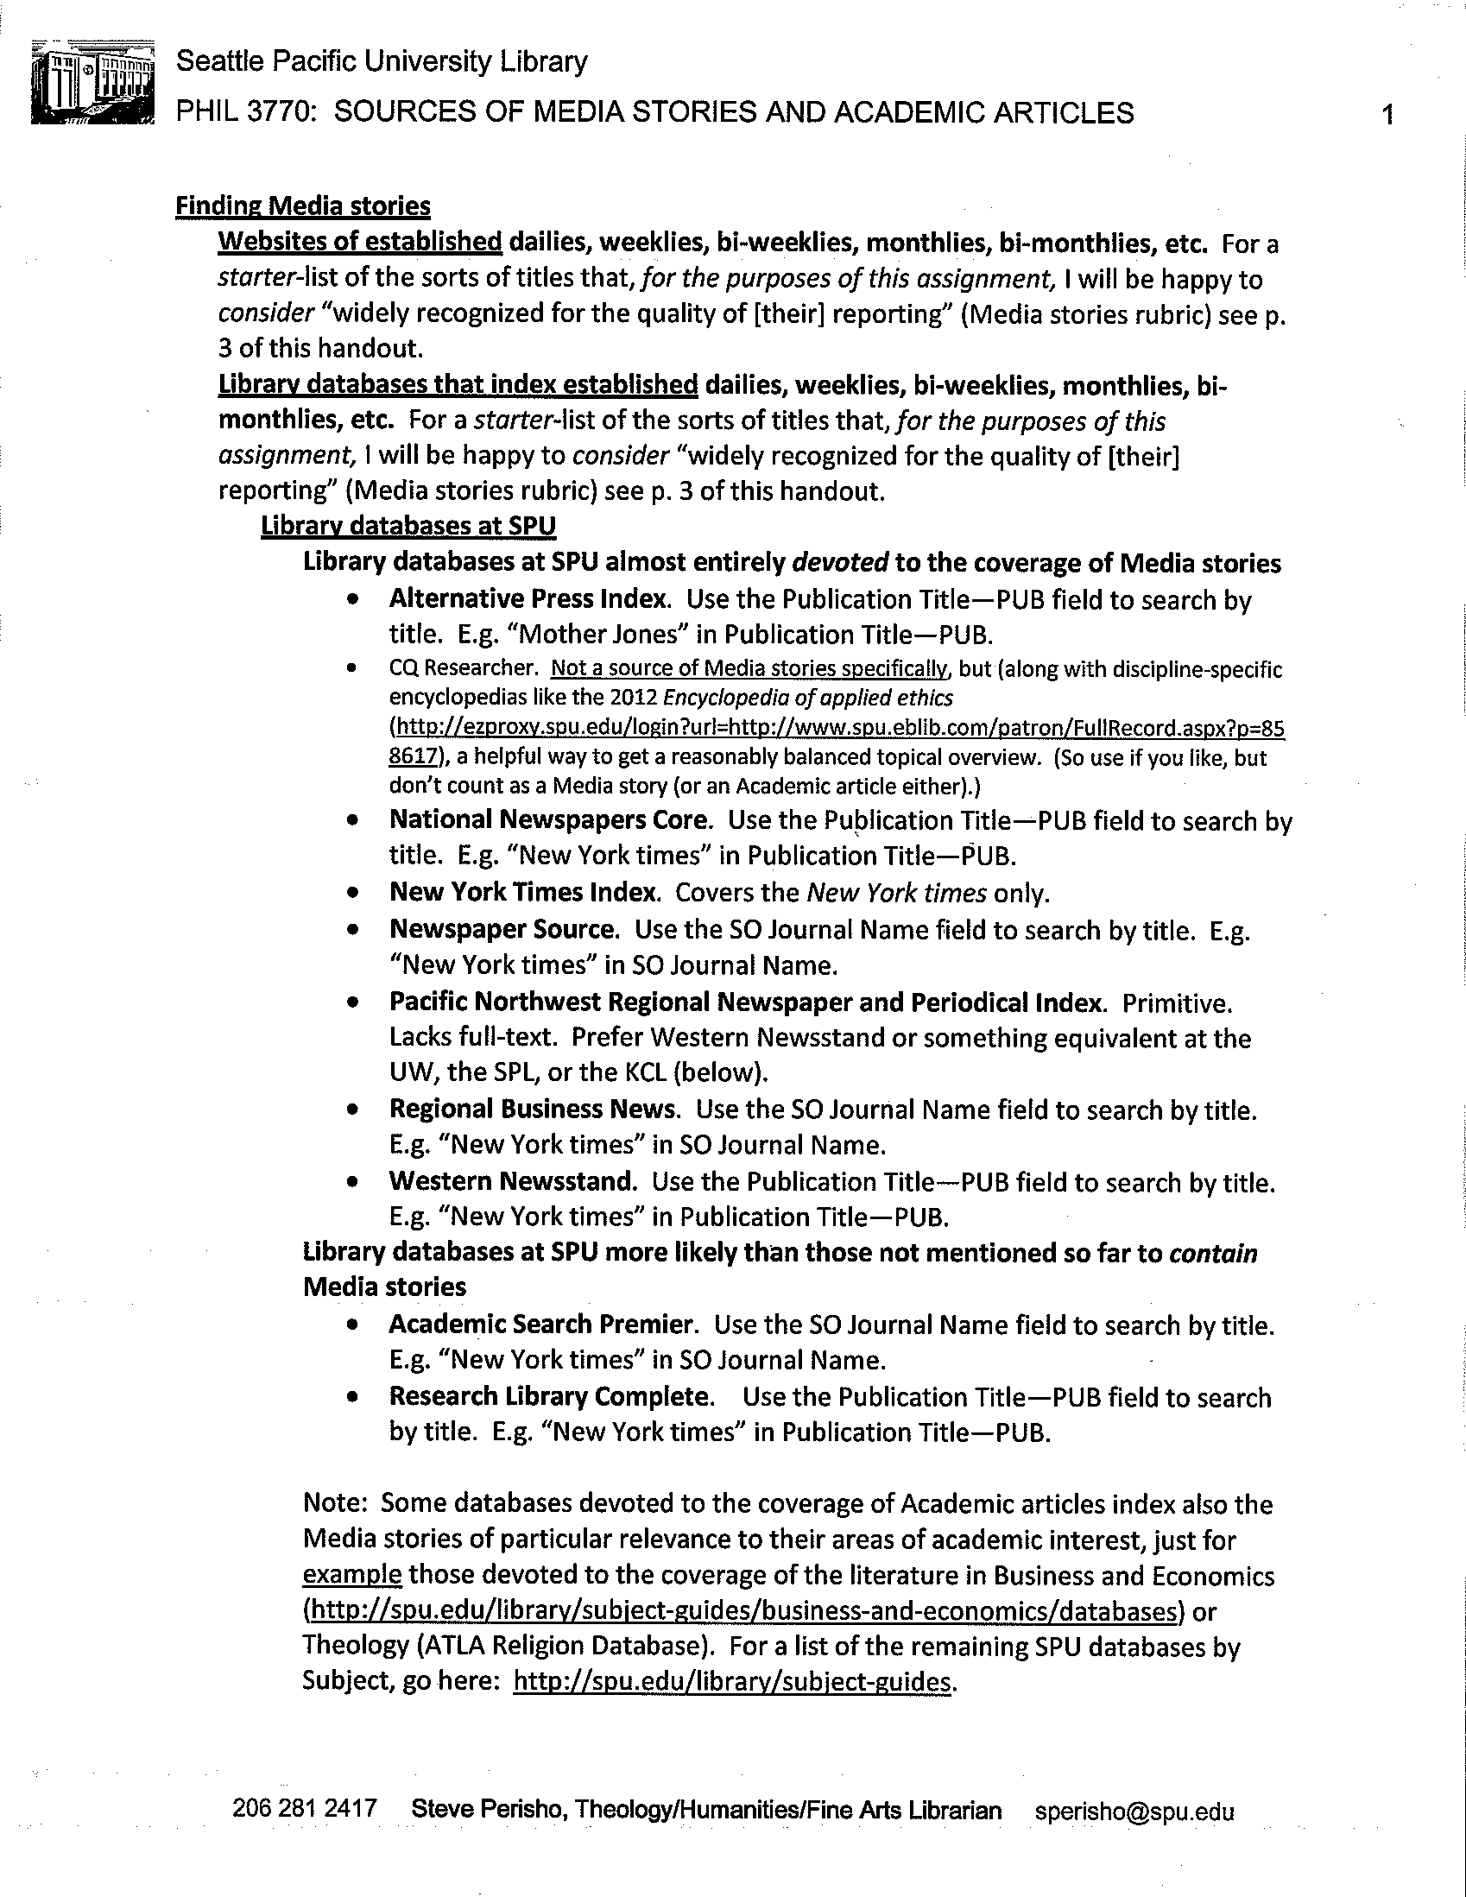

Slide 7
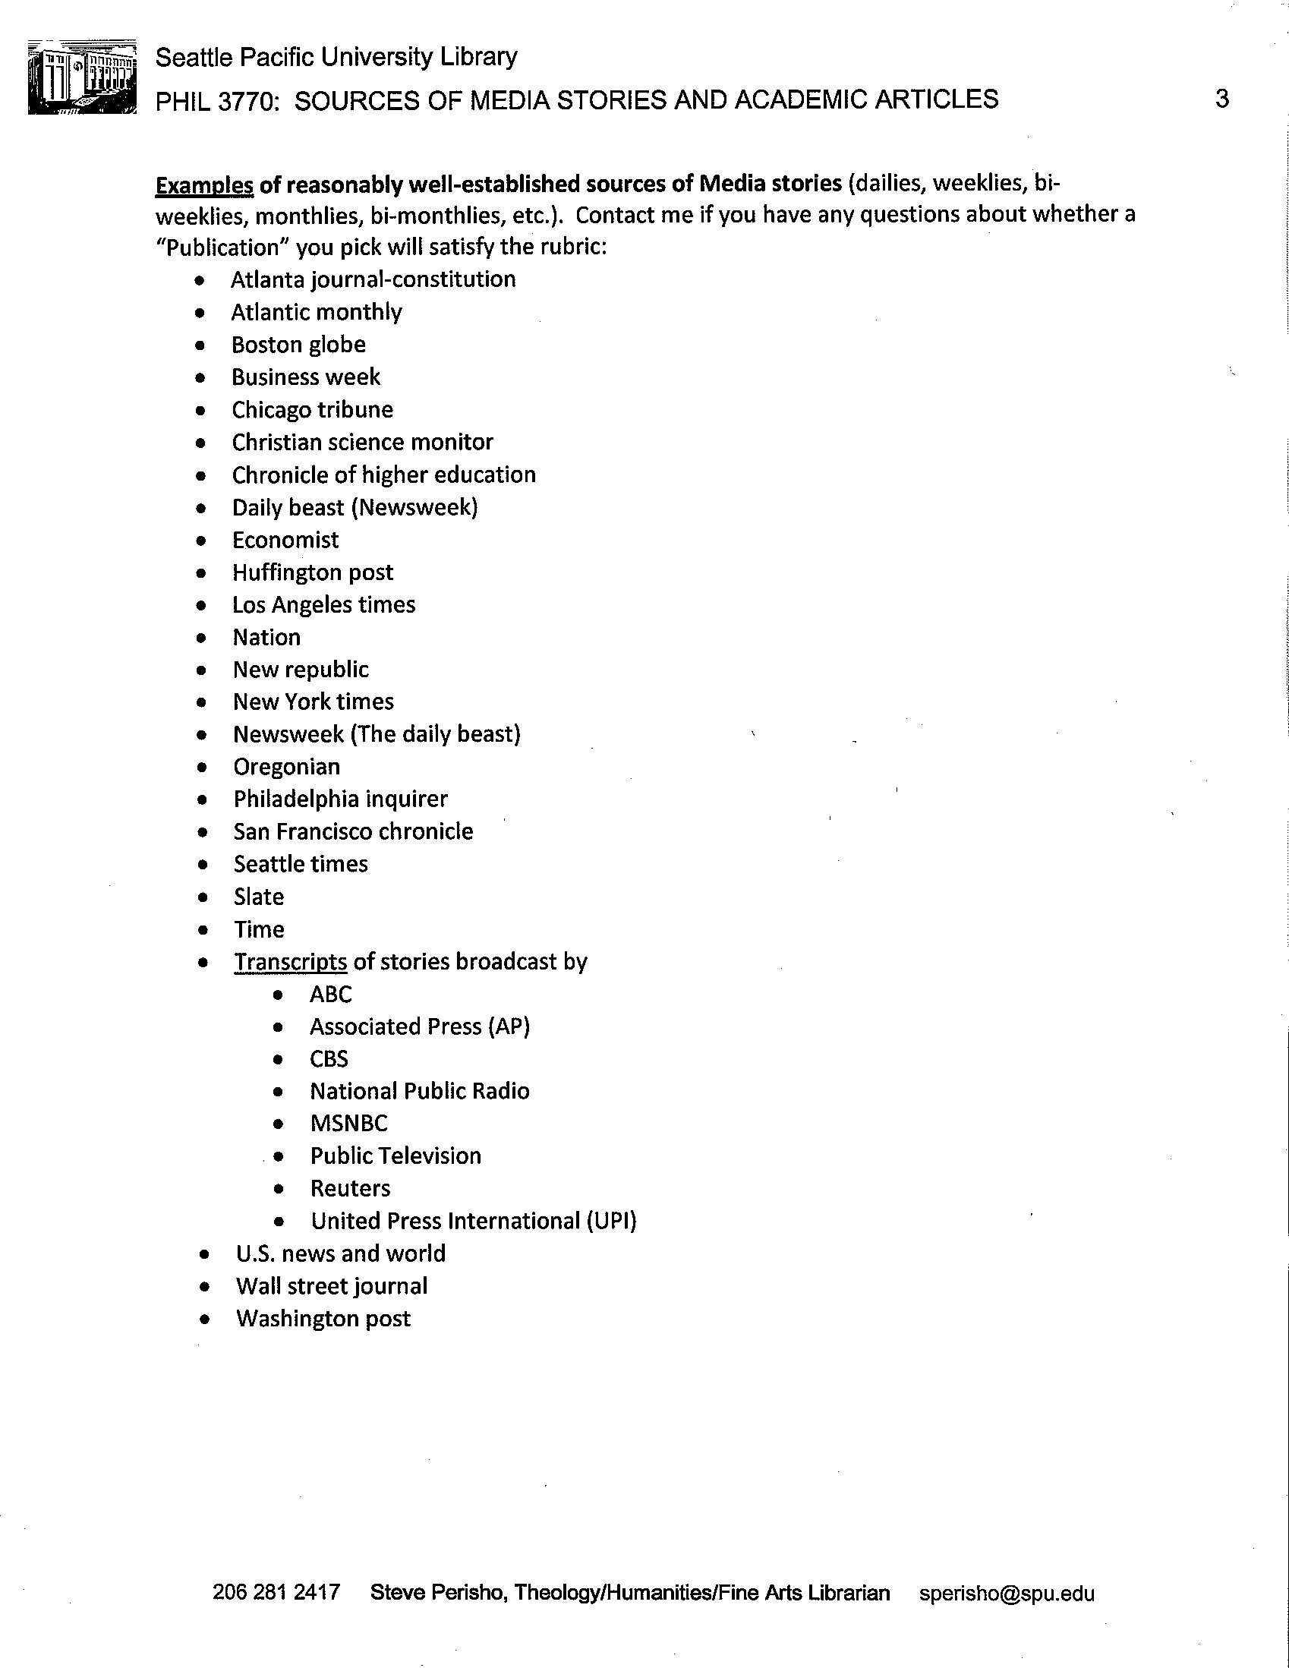

Slide 8


Slide 10


Slide 11


Slide 12
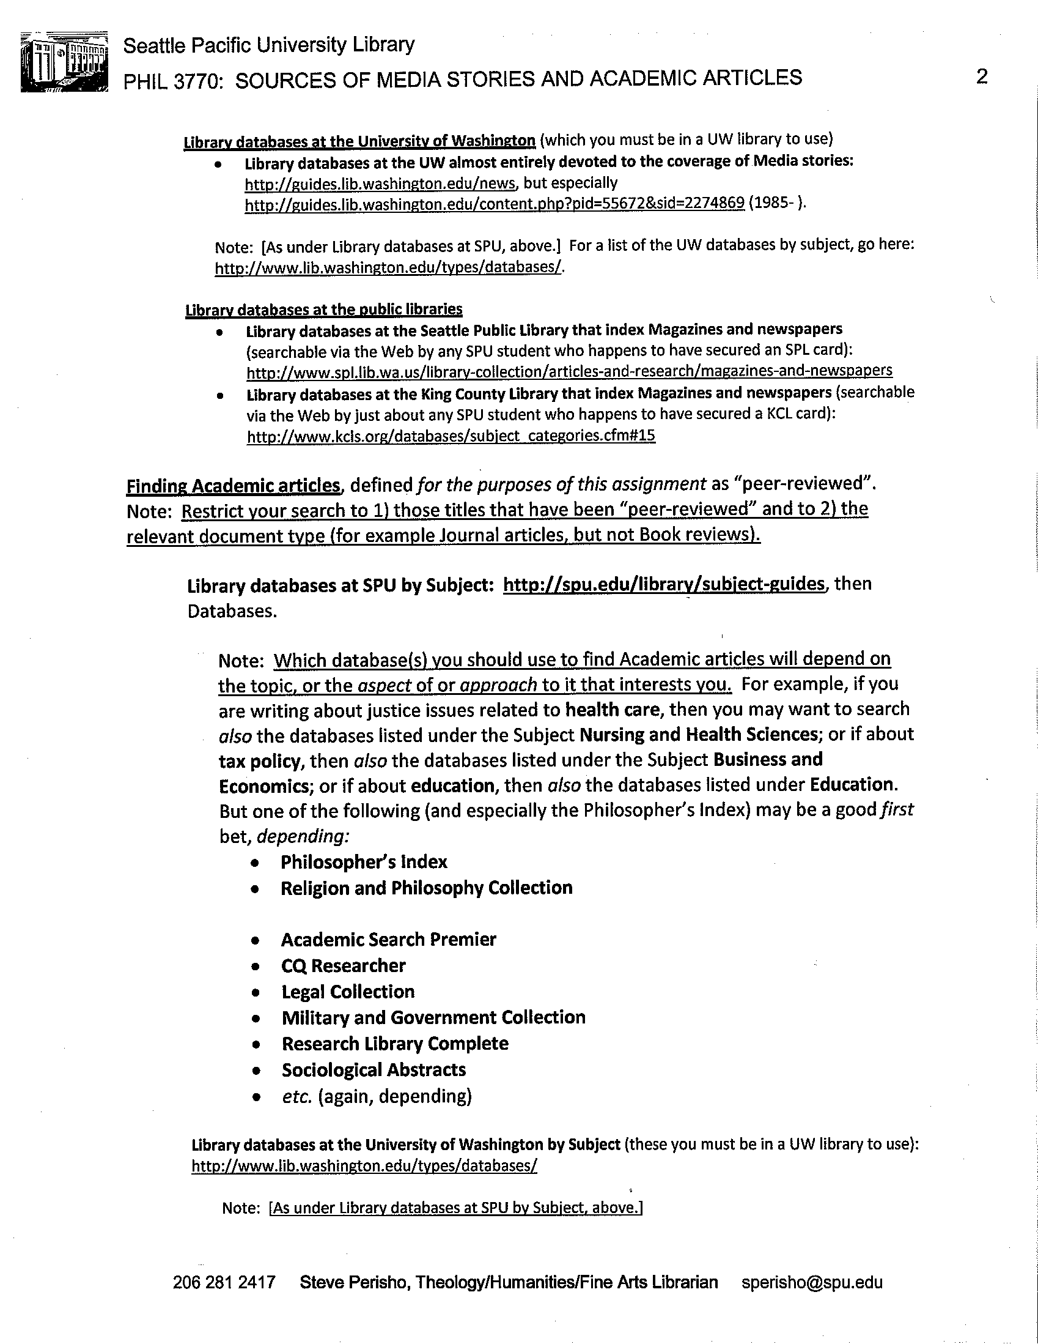

Slide 13
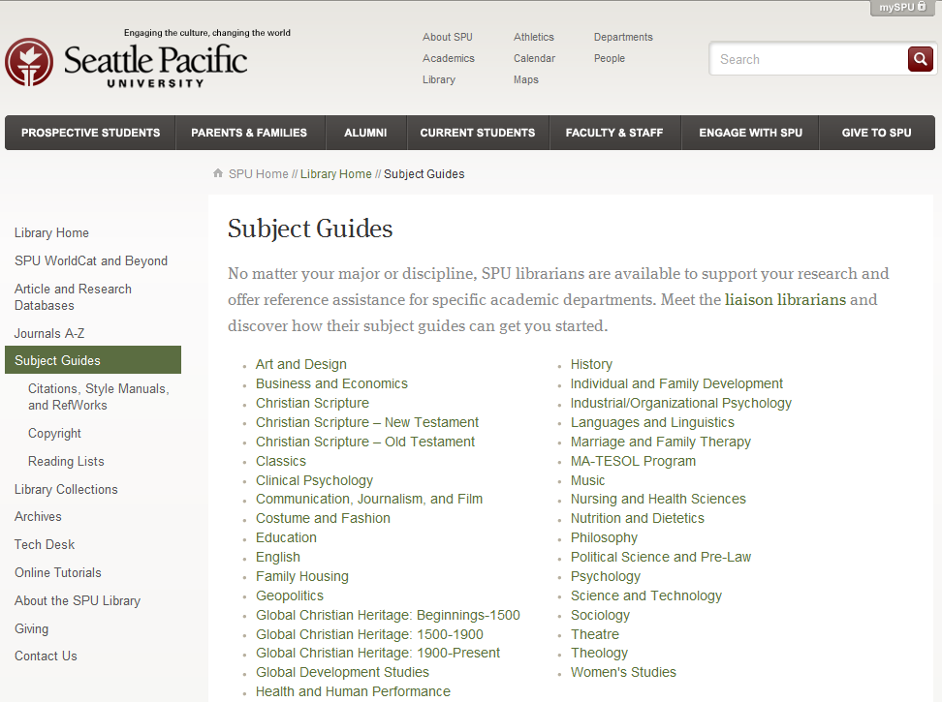

Slide 14


Slide 15


Slide 16
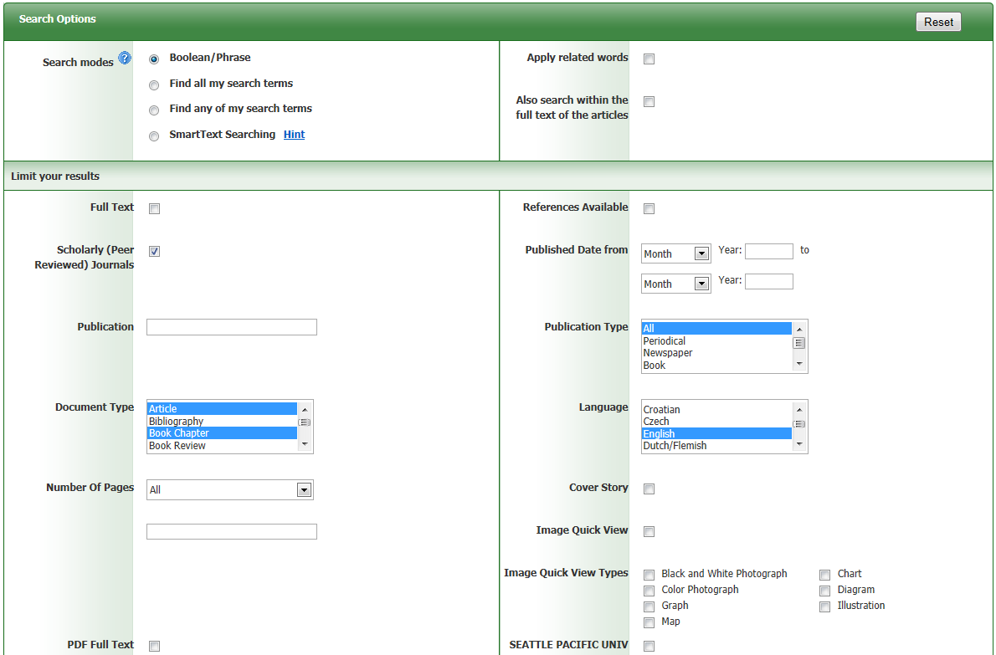

Slide 17
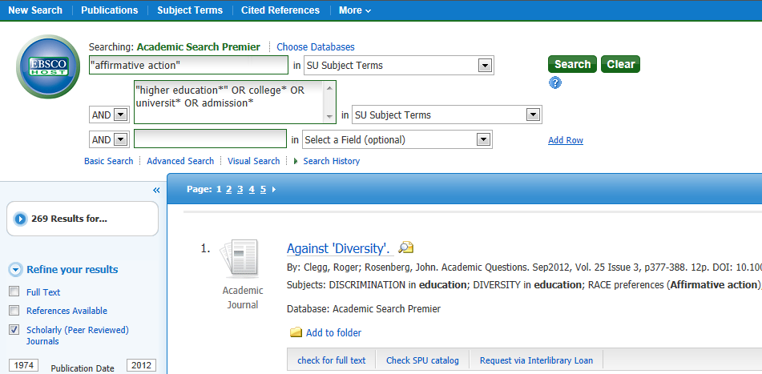
Screen cast: http://www.screencast.com/t/uDc765z7
Internet; UW, SU, etc.

Slide 18
Application

Slide 19
