Slide 1
Library Orientation Session EDU 6120 American Education: Past & Present

Slide 2
Library Orientation
Cindy Strong
Librarian
School of Education
206-281-2074
Office #127
clstrong@spu.edu
Notes:
Bless you

Slide 3
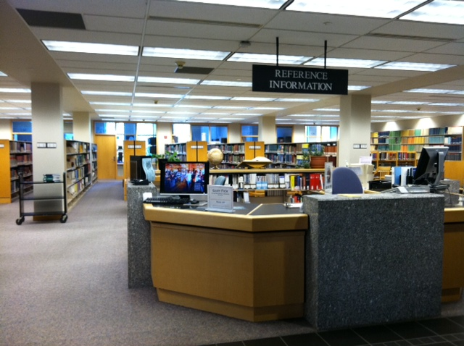
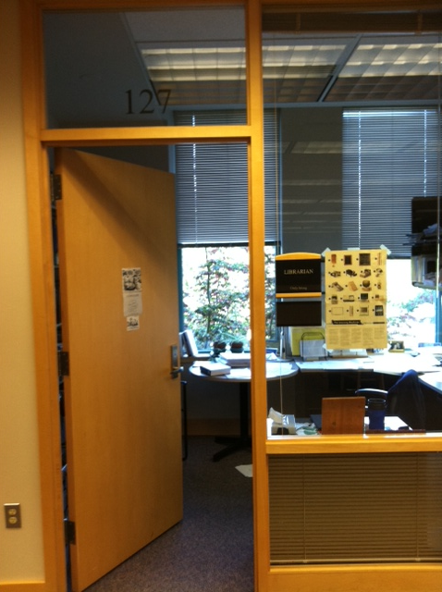
Where I "live" in the library

Slide 4
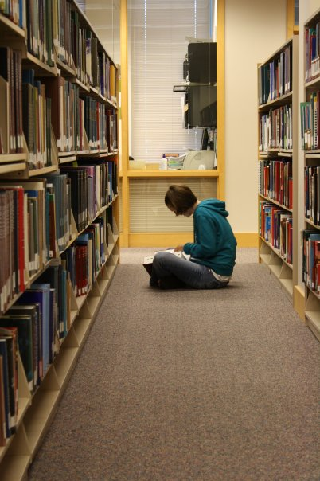
Goals
Help students garner an understanding of the myriad resources available for quality research
….and to have you be aware of who your personal librarian is

Slide 5
Books
Handouts
SPU Catalog--finding books/not articles
ORBIS Cascade Alliance
37 universities and colleges Oregon and Washington
Limit to SUMMIT libraries
Limit to Book
Notes:
Catalog
I will not be explaining the LC system
Handout
Finding books
Try achievement gap
Limit to SUMMIT
Limit to books

Slide 6
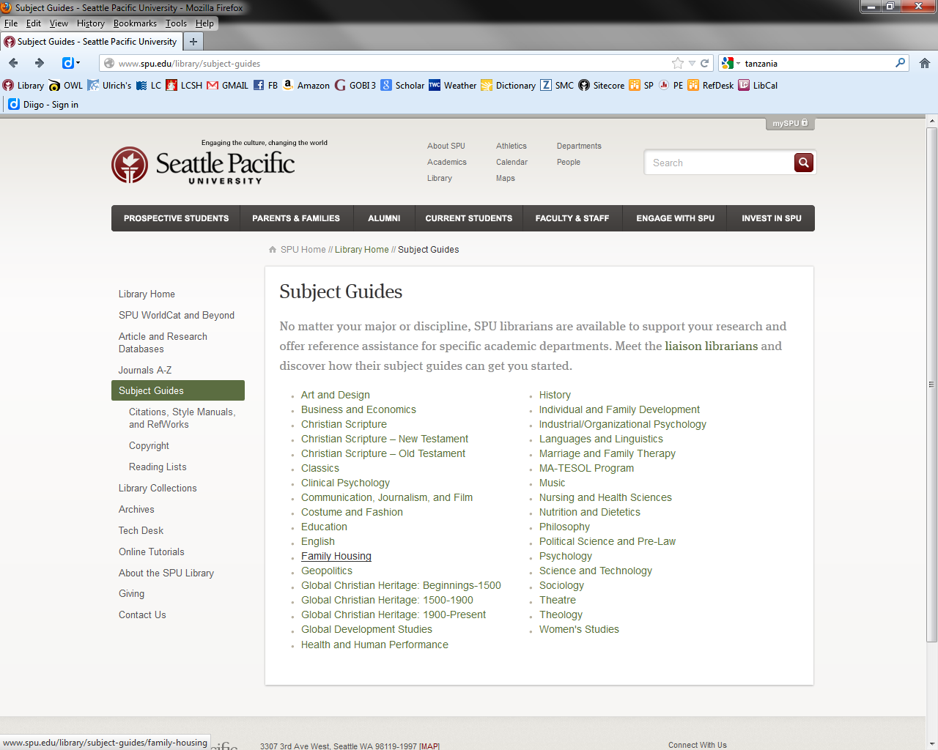
Articles
SPU databases
available remotely
A word about finding full text
APA
Questions
Notes:
Article and Research Databases
Off-Campus Access
Subject guides
Kw: academic achievement AND kw: expla*
Peer reviewed
relevance
Do not check the full text box
“pearl of an article”
# 1 connecting social disorganization theory to african-american outcomes to explain the achievement gap
Su: achievement gap
Su: african americans
Su: racial composition
Su: at risk students
# 10 An empirical test of five prominent explanations for the black-white
Su: african american students
APA—apa style guide to electronic references

Slide 7
Notes:
What questions do you still have

